Slide 1
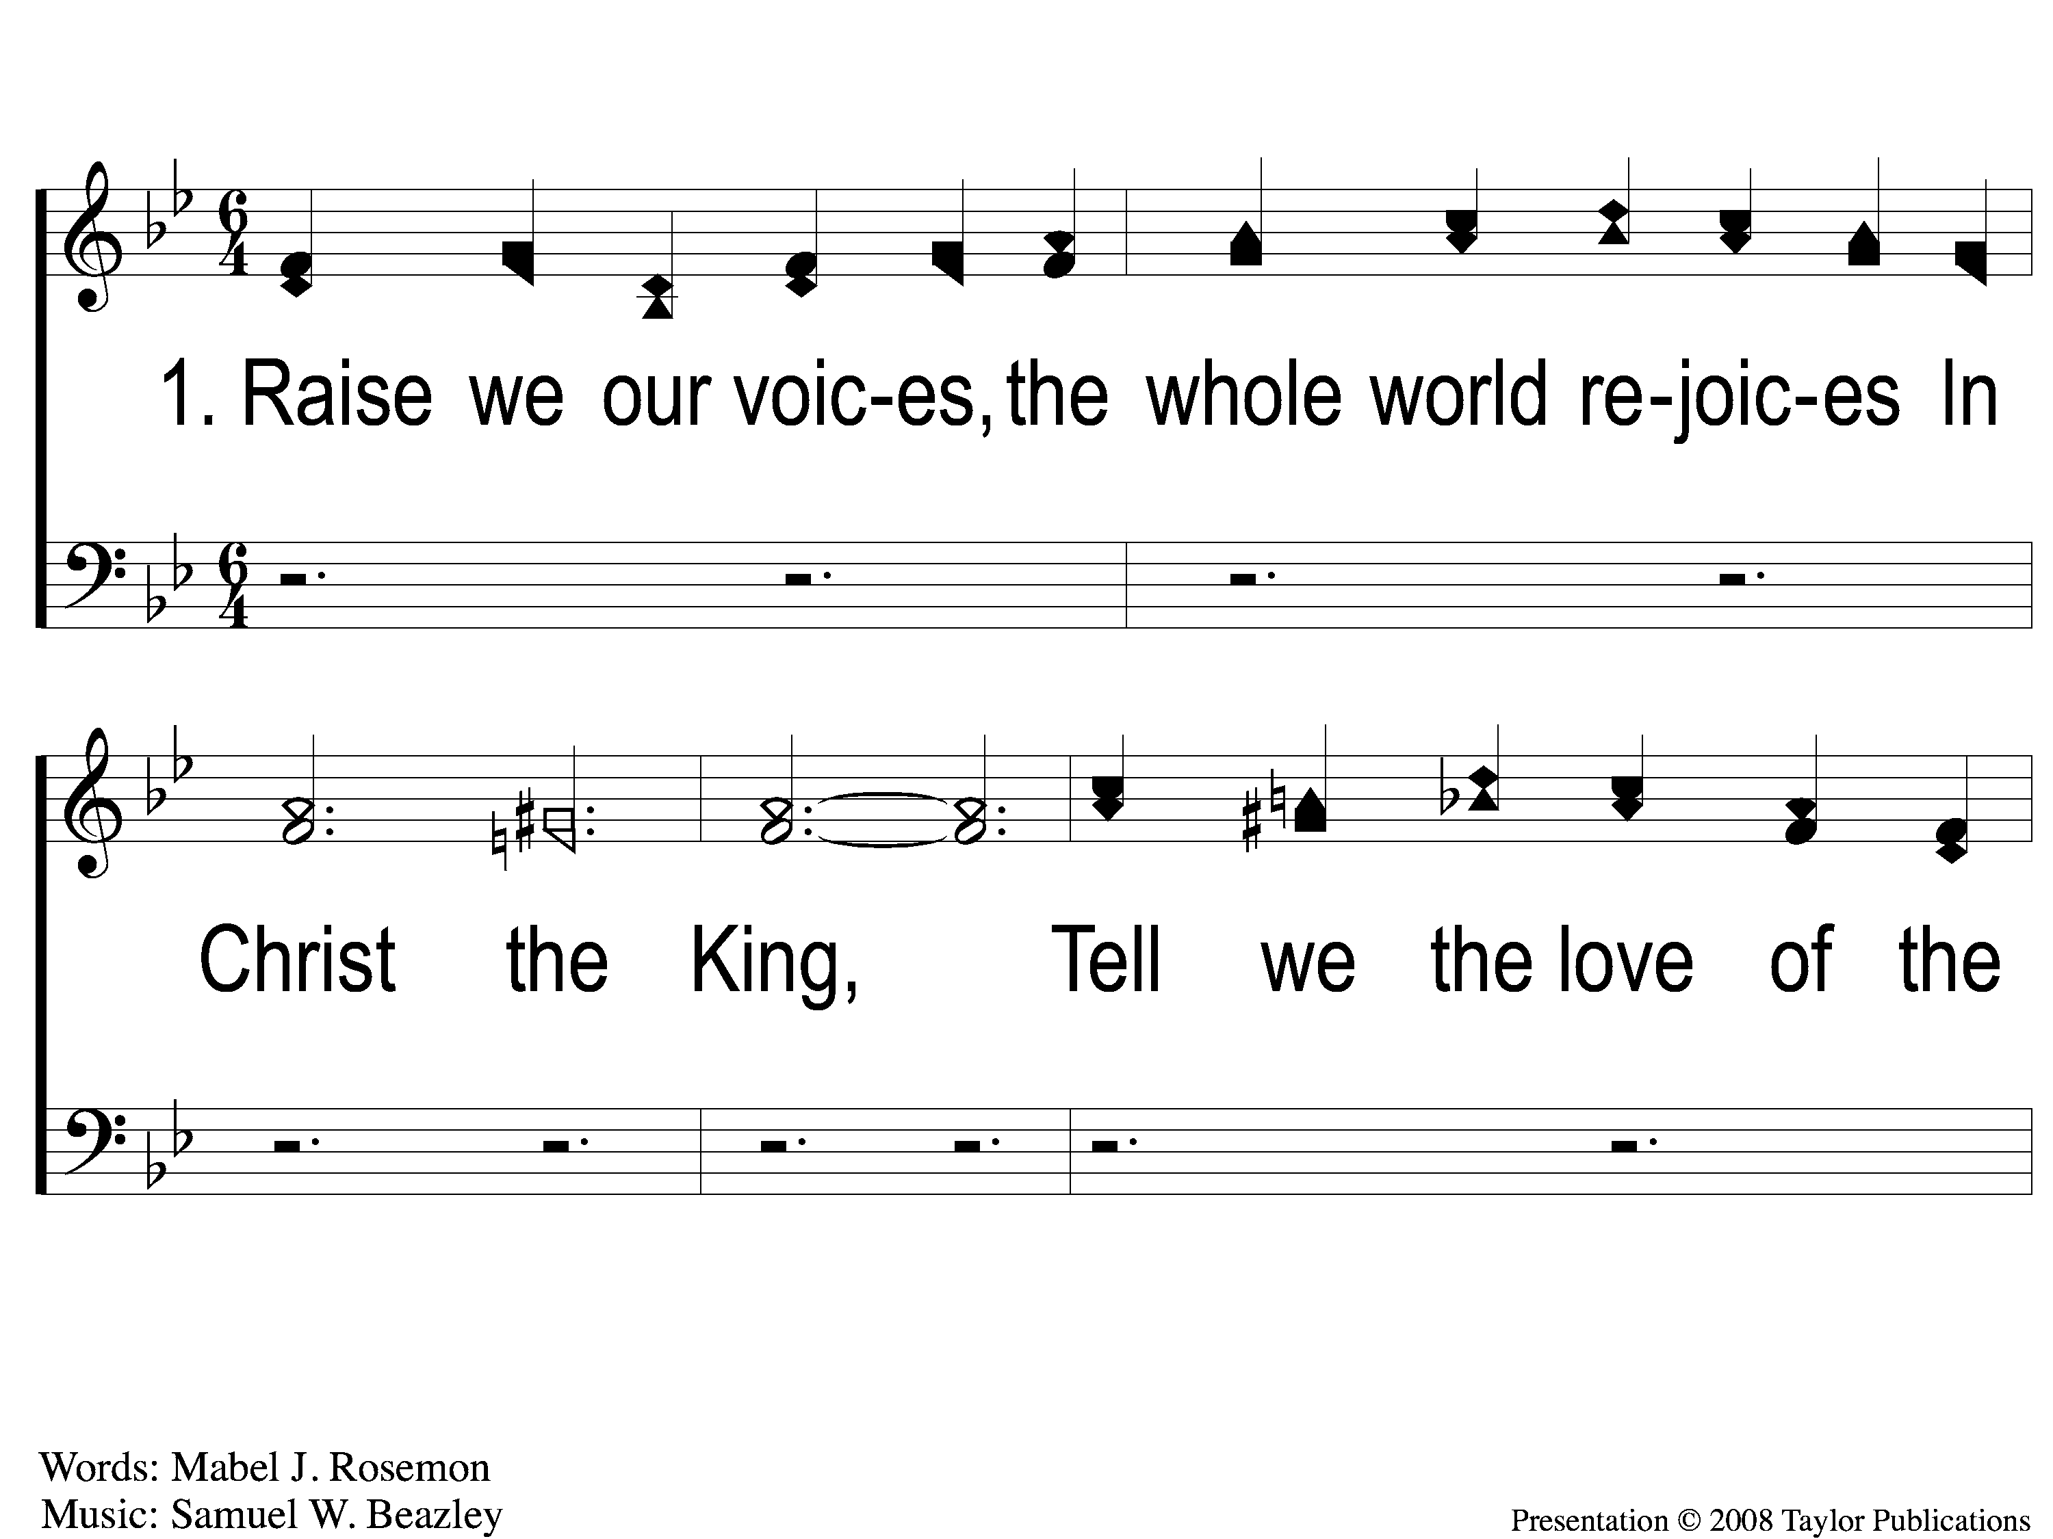
1-1 Glory and Honor
Glory and Honor
130

Slide 2
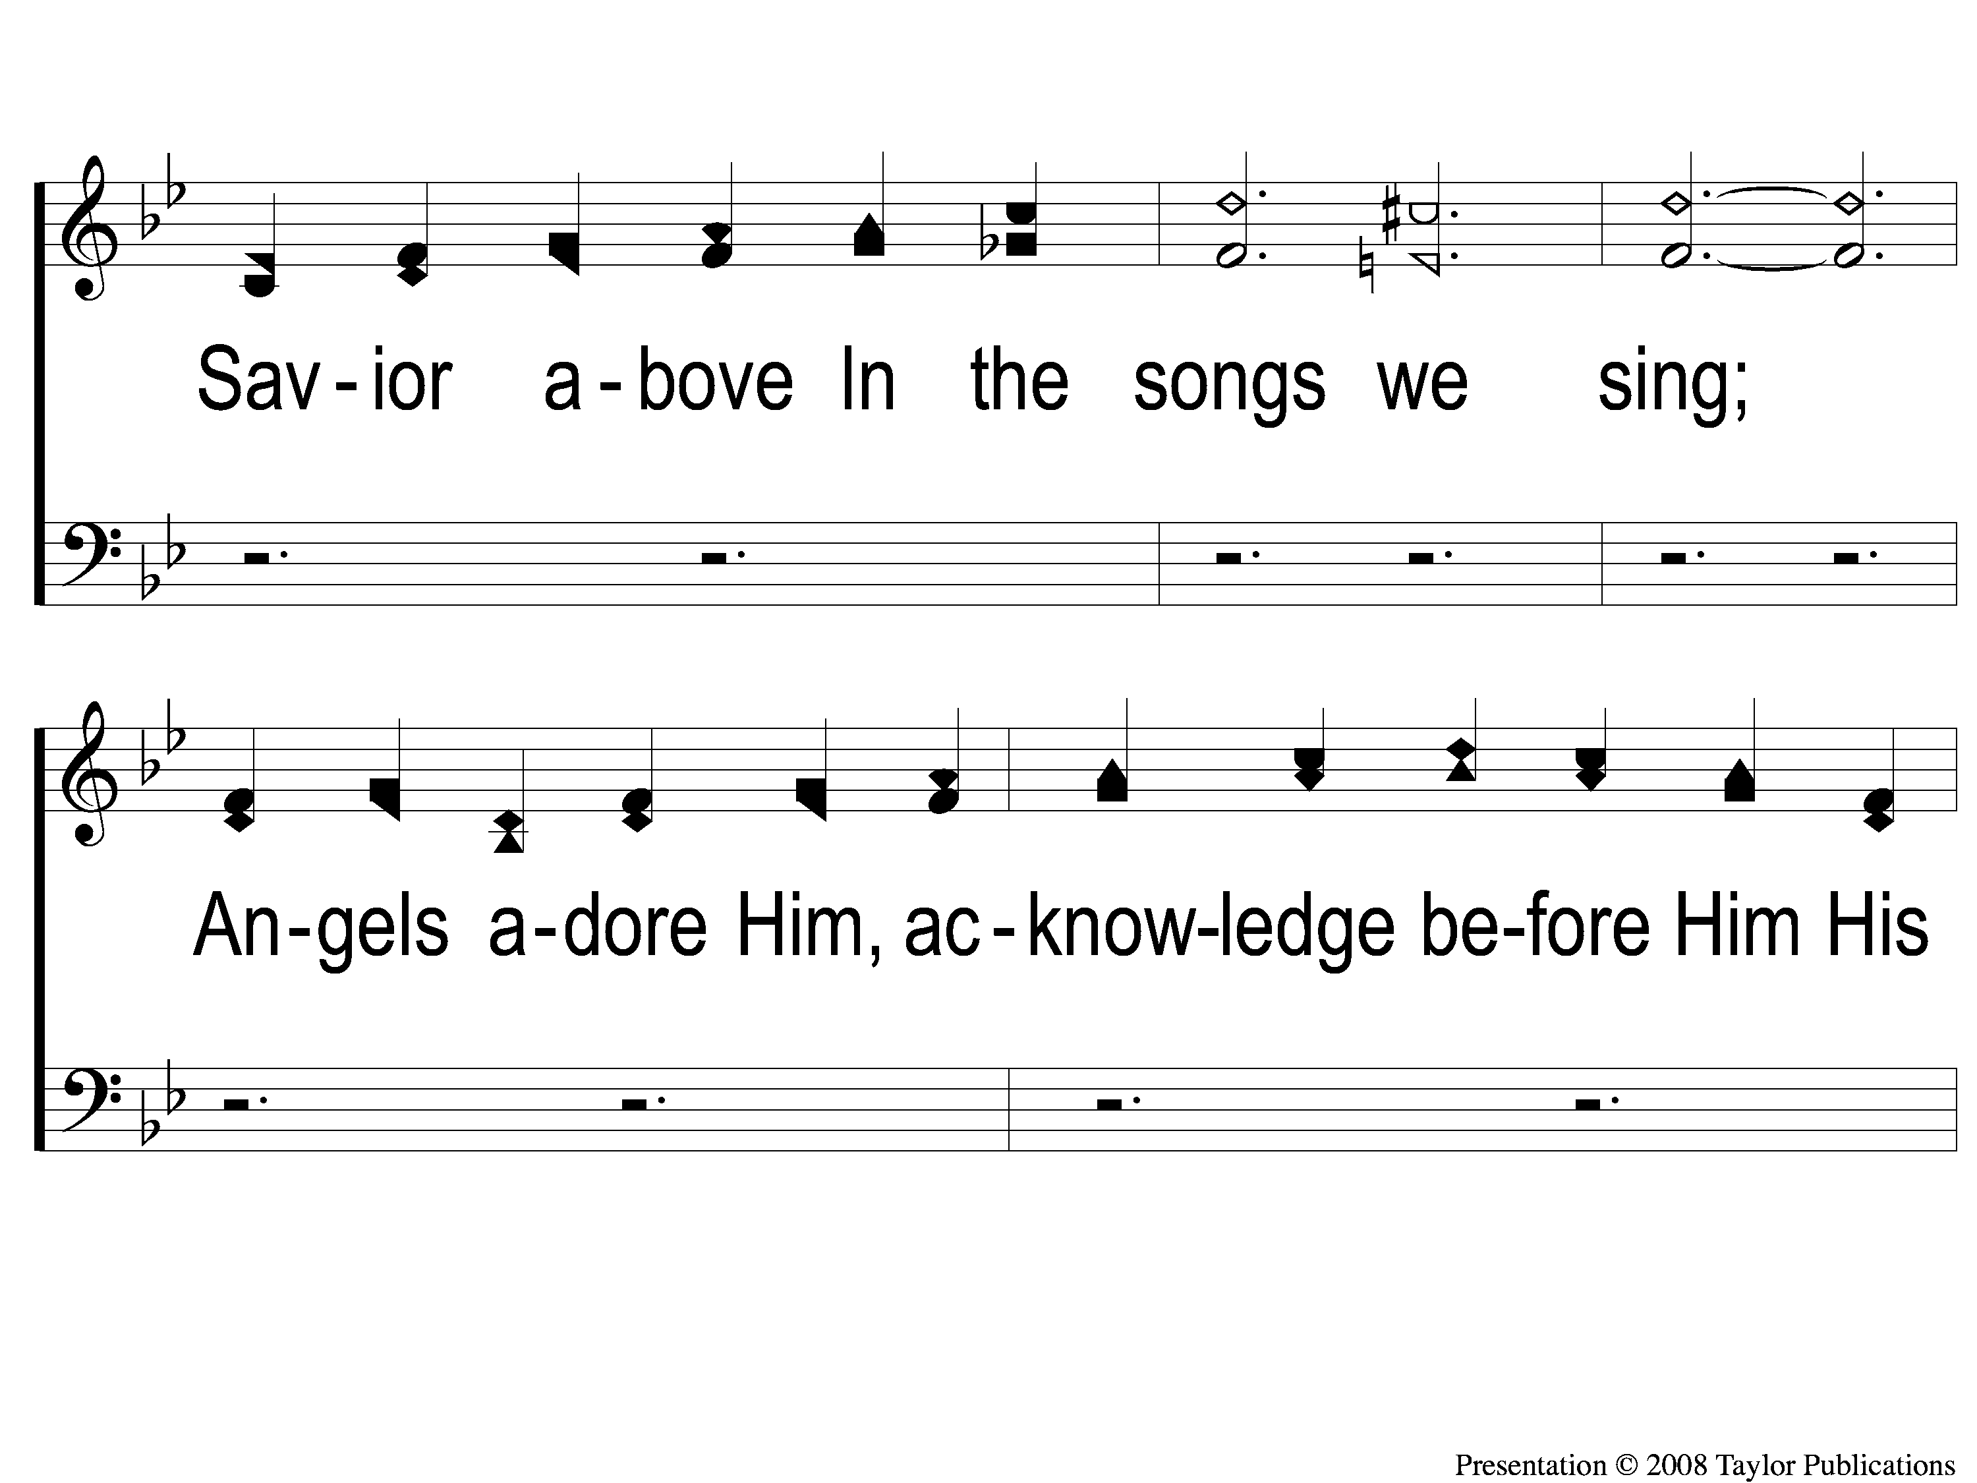
1-2 Glory and Honor
Glory and Honor
130

Slide 3
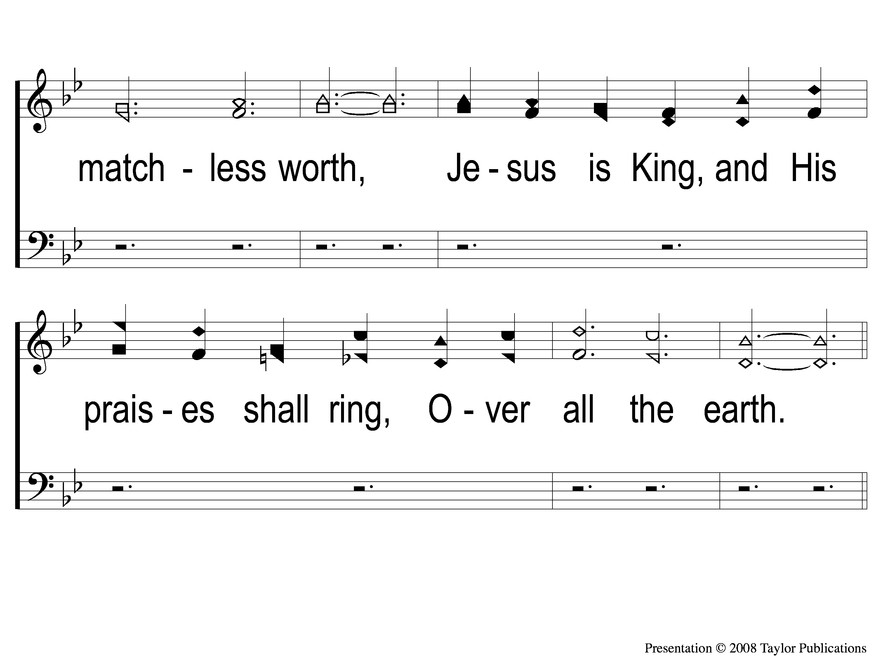
1-3 Glory and Honor
Glory and Honor
130

Slide 4
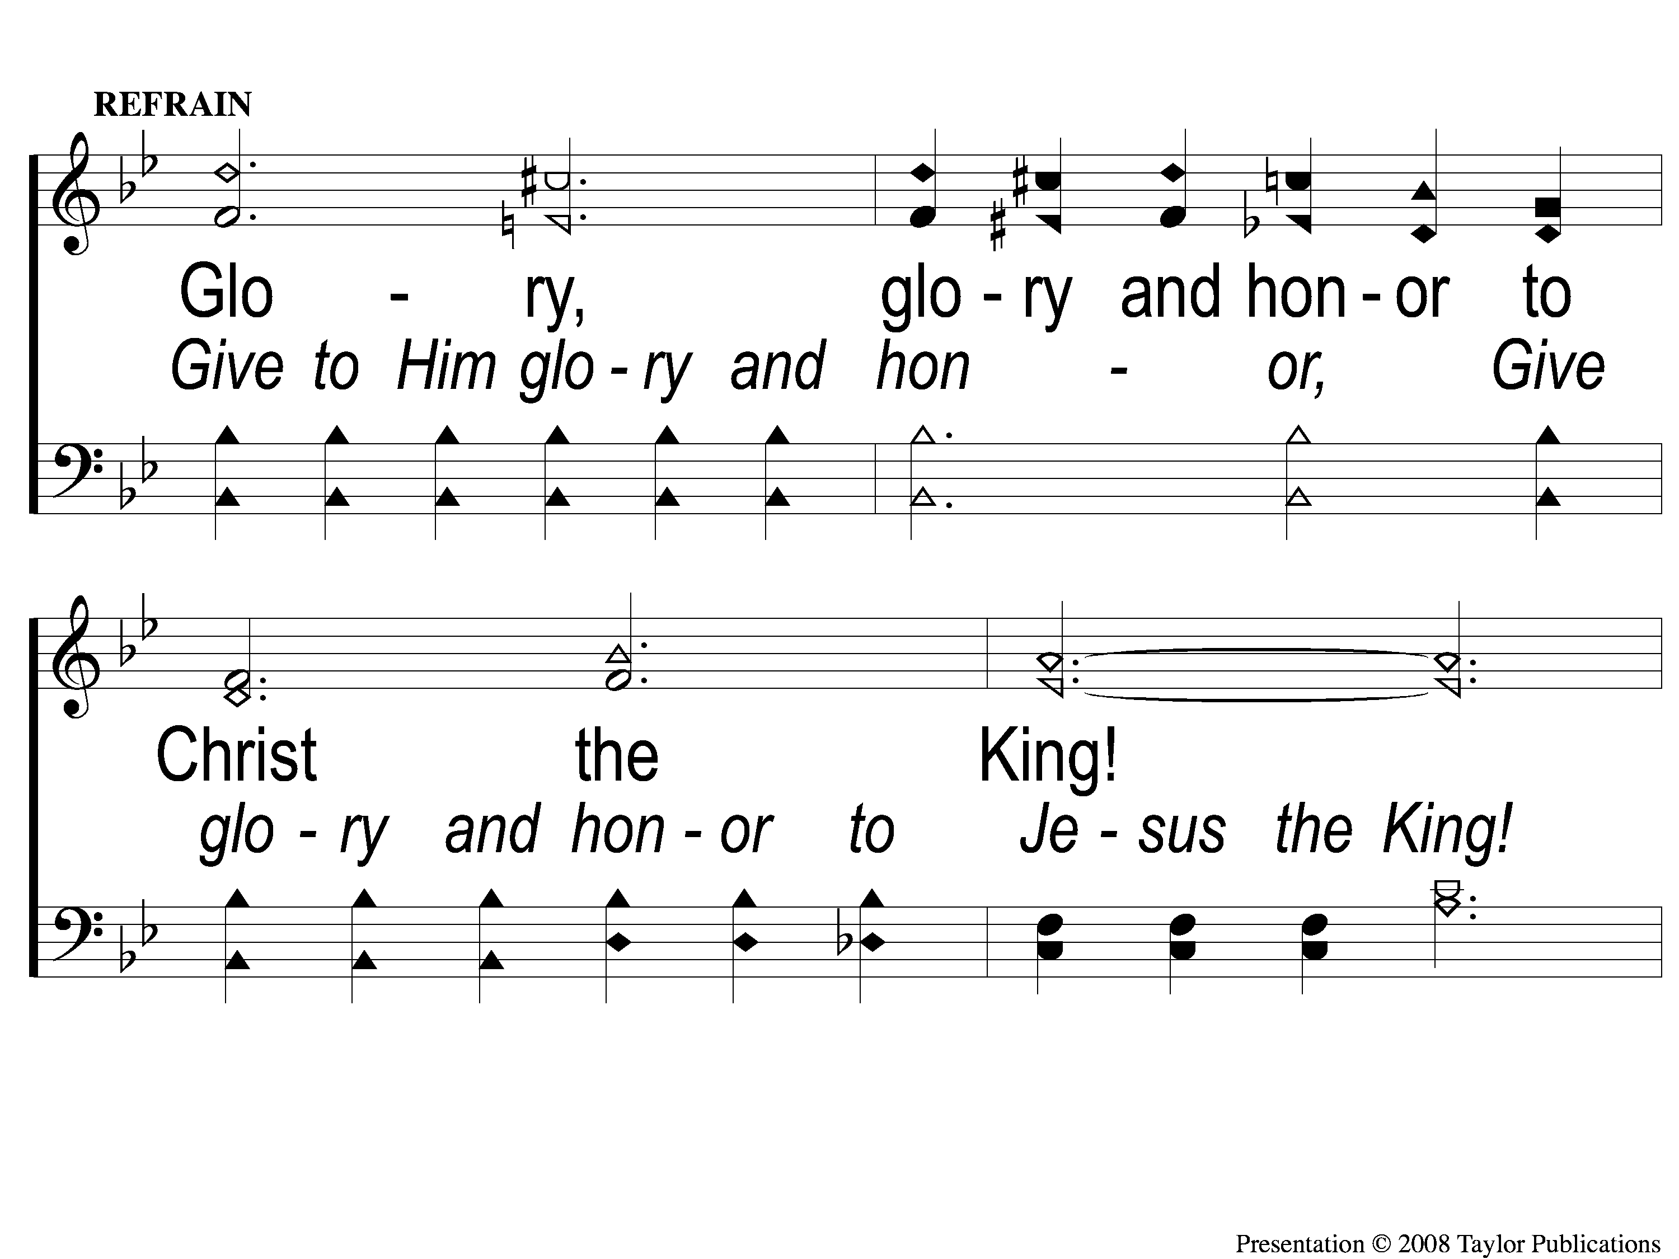
C-1 Glory and Honor
Glory and Honor
130

Slide 5
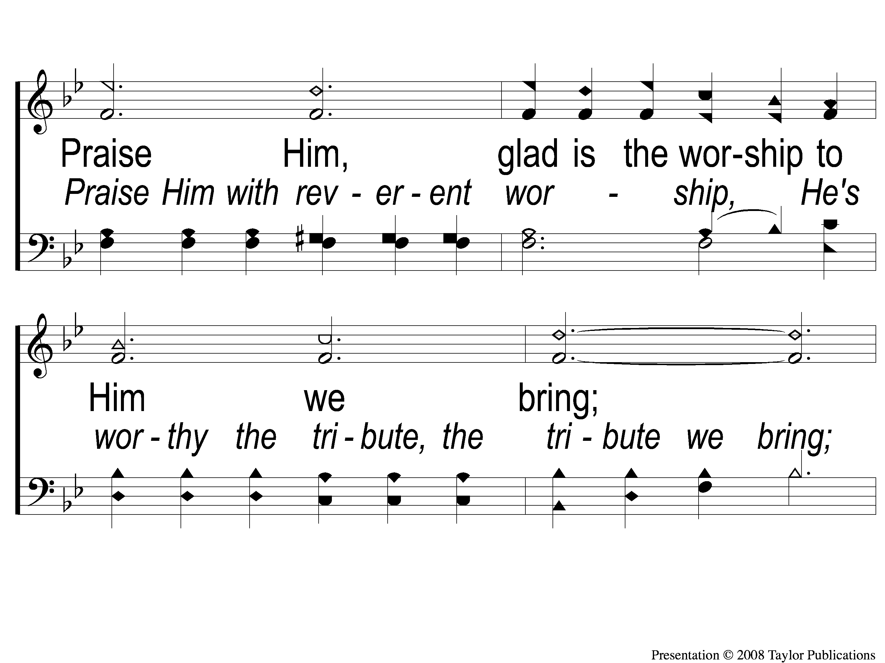
C-2 Glory and Honor
Glory and Honor
130

Slide 6
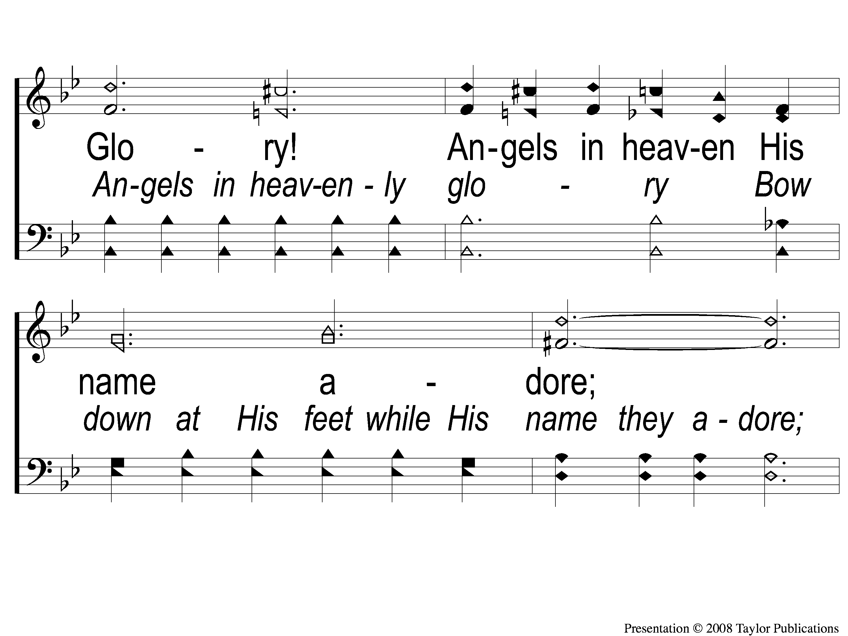
C-3 Glory and Honor
Glory and Honor
130

Slide 7
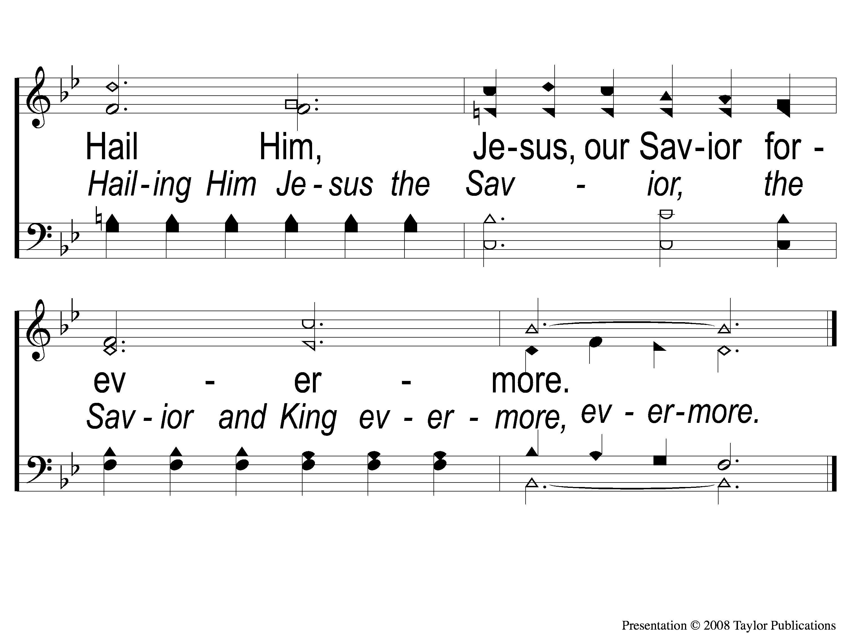
C-4 Glory and Honor
Glory and Honor
130

Slide 8
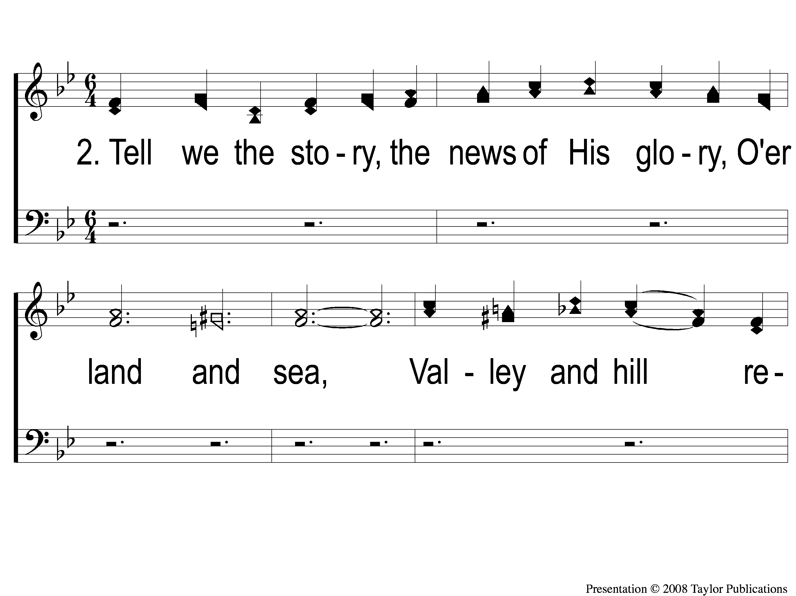
2-1 Glory and Honor
Glory and Honor
130

Slide 9
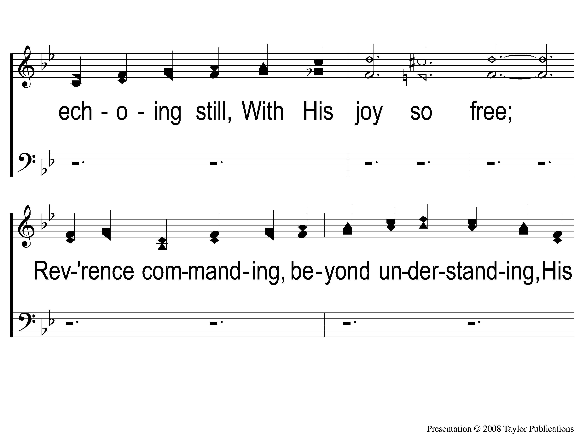
2-2 Glory and Honor
Glory and Honor
130

Slide 10
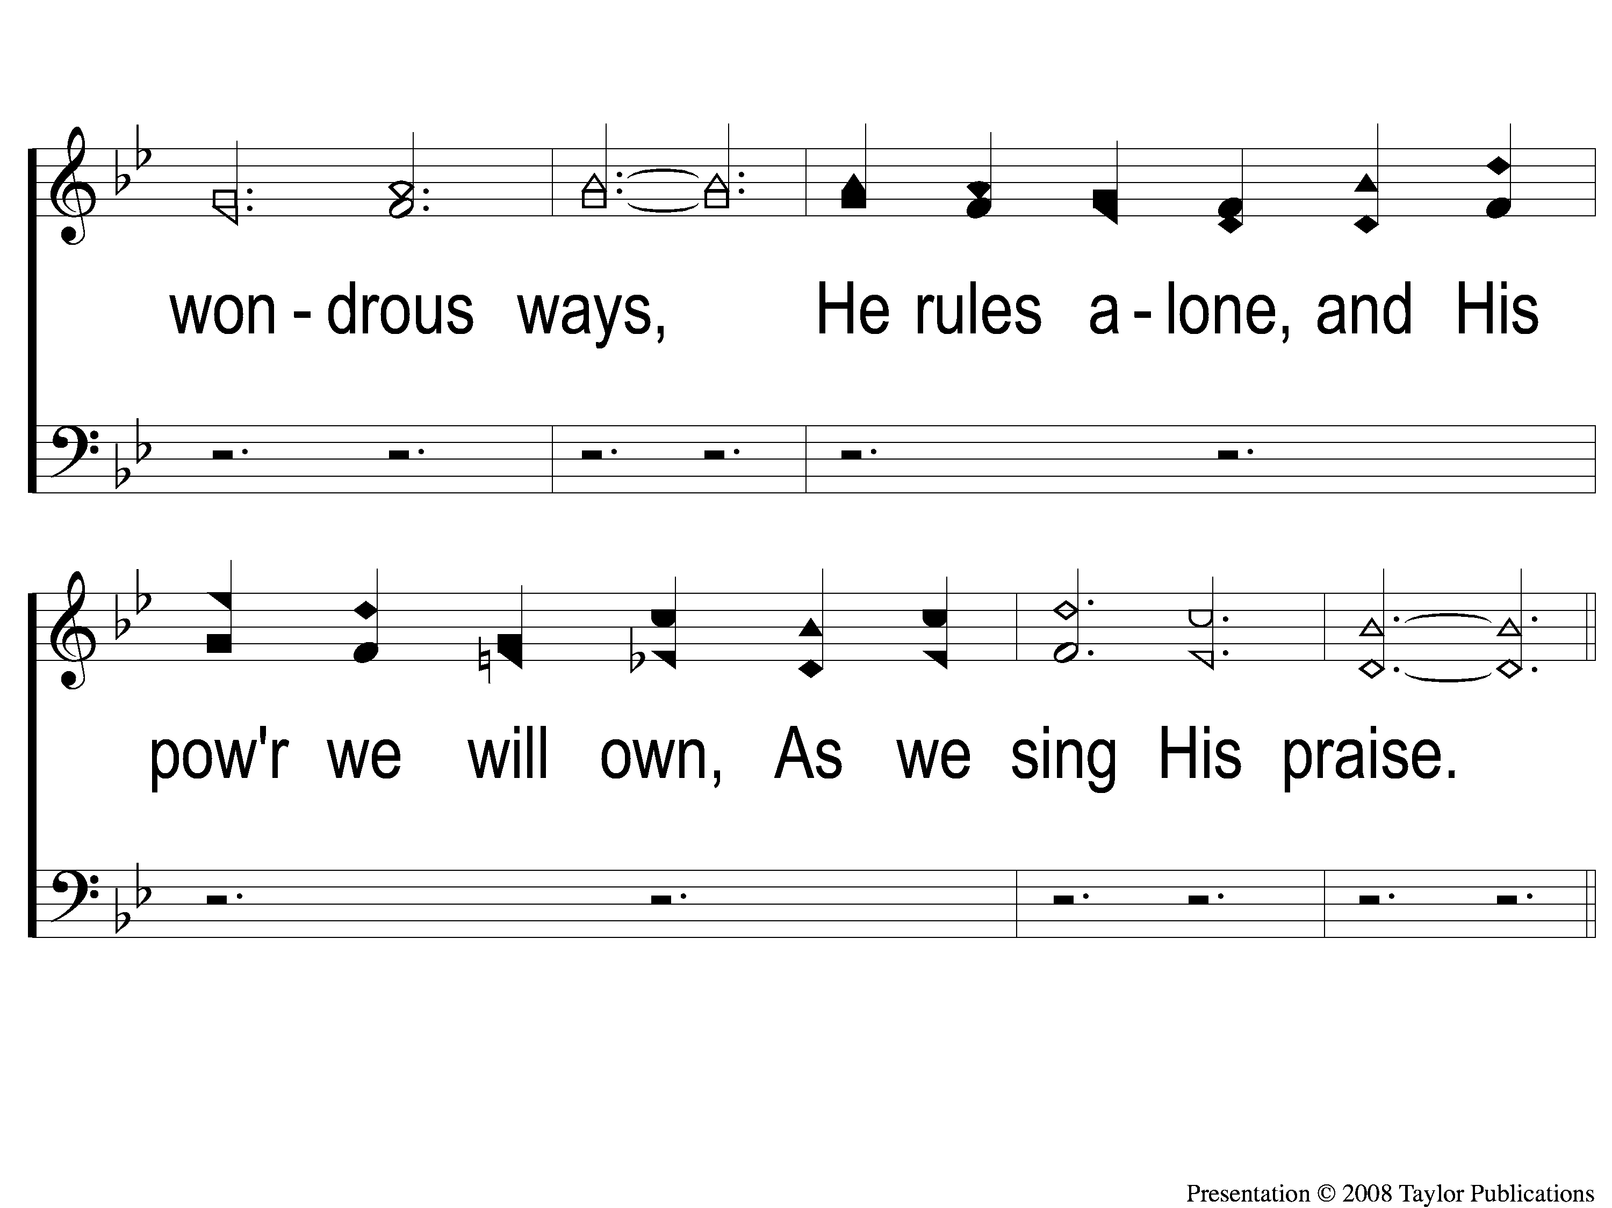
2-3 Glory and Honor
Glory and Honor
130

Slide 11
C-1 Glory and Honor
Glory and Honor
130

Slide 12
C-2 Glory and Honor
Glory and Honor
130

Slide 13
C-3 Glory and Honor
Glory and Honor
130

Slide 14
C-4 Glory and Honor
Glory and Honor
130

Slide 15
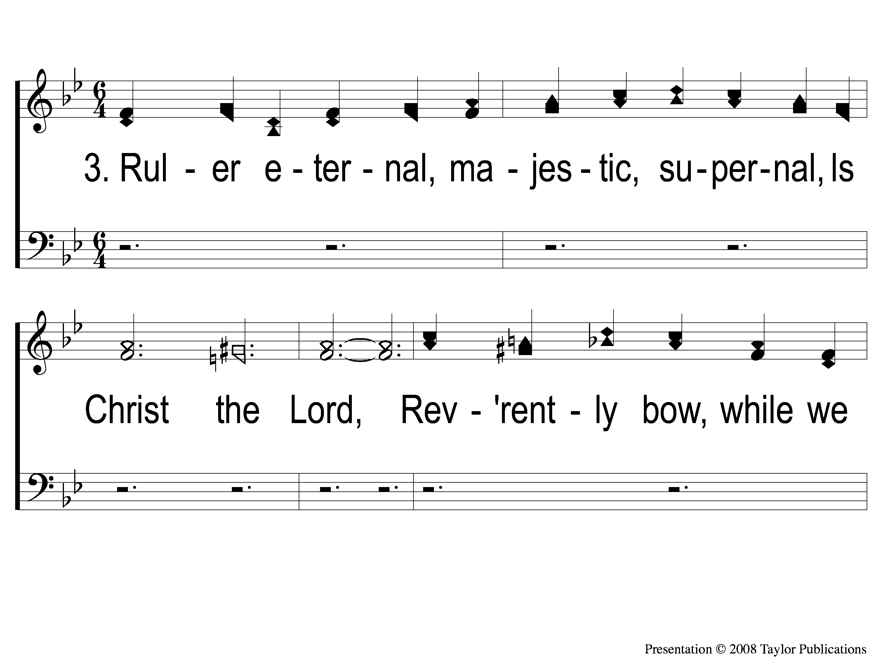
3-1 Glory and Honor
Glory and Honor
130

Slide 16
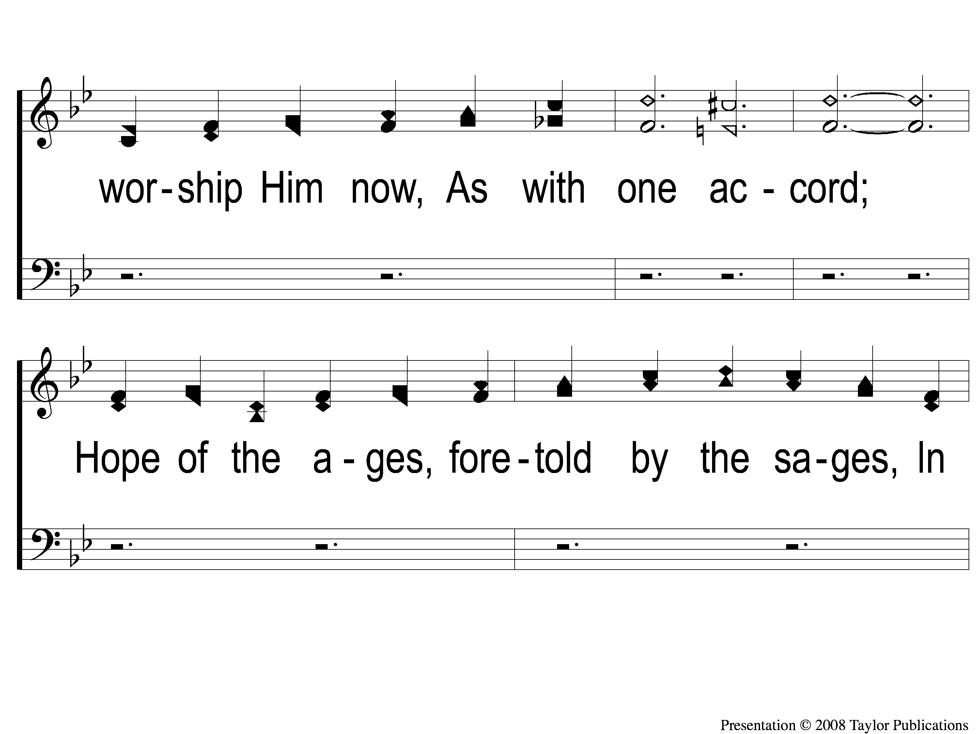
3-2 Glory and Honor
Glory and Honor
130

Slide 17
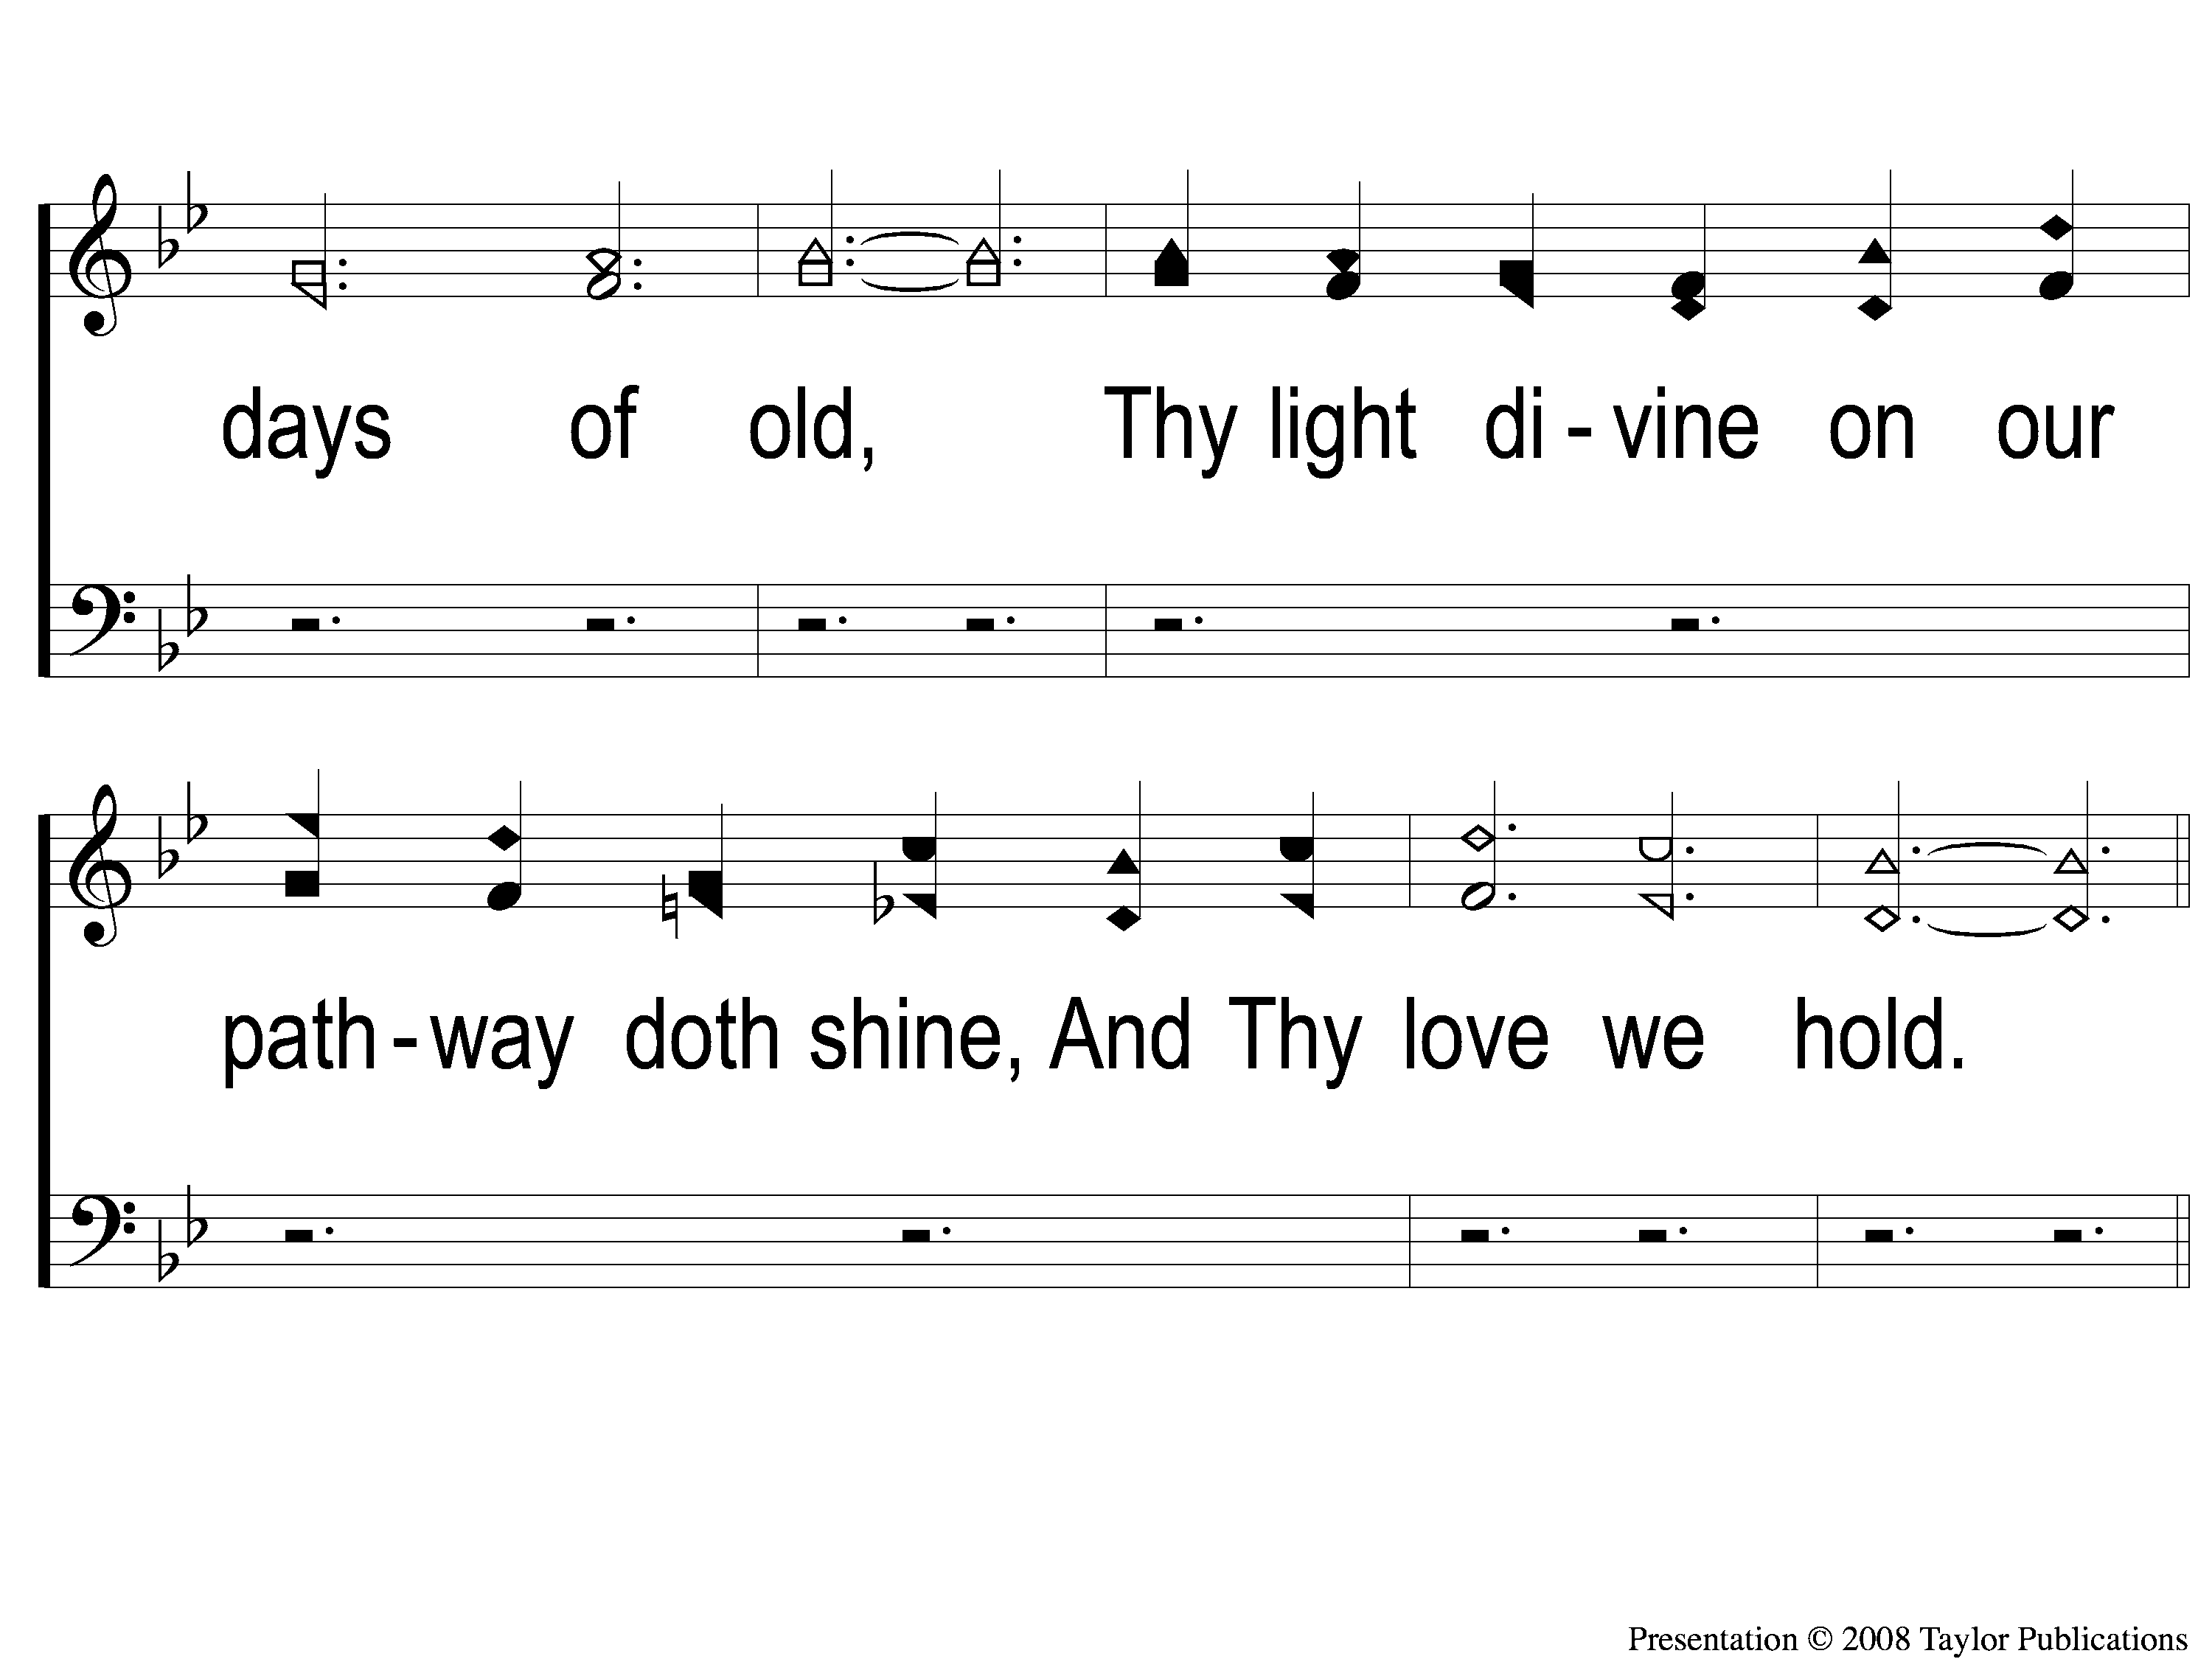
3-3 Glory and Honor
Glory and Honor
130

Slide 18
C-1 Glory and Honor
Glory and Honor
130

Slide 19
C-2 Glory and Honor
Glory and Honor
130

Slide 20
C-3 Glory and Honor
Glory and Honor
130

Slide 21
C-4 Glory and Honor
Glory and Honor
130

